Slide 1

QUALITICS - BUTS
Patika.Dev - 110 VitrA Data Science Bootcamp Project
Group 2
Members: Regaip KURT, Canberk BULUT, Ayşe FIRAT, İsmail Sadi CESUR
Mentors: Utku BEZEK, Miray DOĞAN
Lecturer: Çağlar SUBAŞI
September, 2021

Slide 2
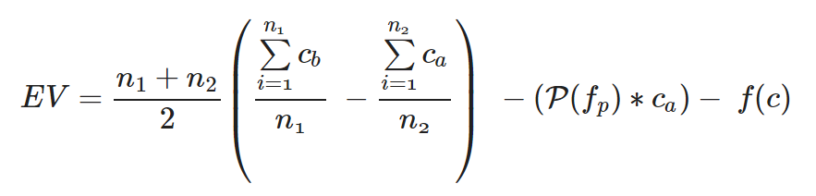
PURPOSE & Expected Value Framework
Purpose: Goal of this project is to reveal the features of manufacturing that leads to poor quality.
Various sensor datum are examined with different models to predict defective products.
Expected Value Framework: The expected benefit of the project is to find causes of the defective products and hence by designing the production line again to reduce the number of defective products.
Hence benefit can be financially described as the difference between the cost of defective products before the project and after the project.
EV represents Expected Value and Expected Value equals to difference between Expected Benefit minus Expected Loss
EV=EB−EL
f(c) is the cost function of the project. n is the total number of products and ca and cb are the cost of the defective product respectively after the project and before the project. P(fp) represents false positives made by models

Slide 3
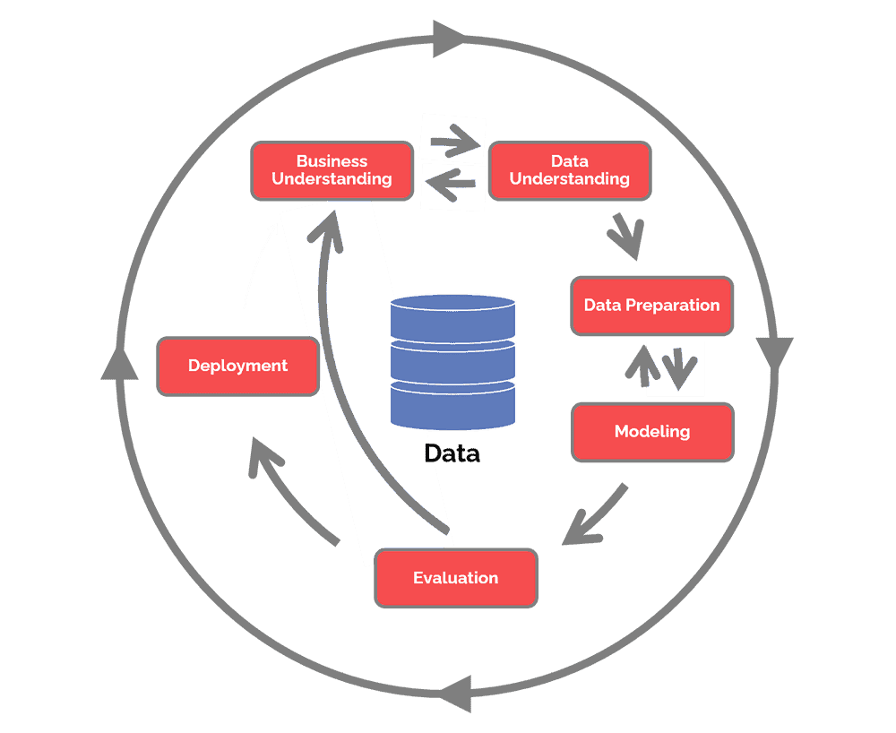
CRISP - DM
First we got information from business department and then we tried to grasp deeply the dataset by using visualization techniques.
Business information has been given by the company's data science team to group. We defined an expected value framework above with respect to these informations.
Missing value handling,
Outlier handling. Converting data types and creating new columns for quality, shifts and datetimes.
Since we have no intention to use this analysis in real world application we don't have to deploy our models and analysis.
We used statistical tests and different models to optimize the problem.
Statistical test will be examined by its own methods. Since we have a classification problem we will use models which is convenient to this problem.

Slide 4
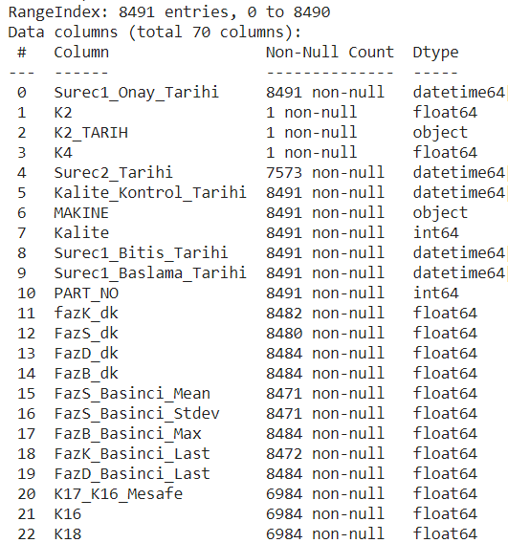
DATA UNDERSTANDING
Qualitics dataset has 59 columns and 8491 rows obtained from sensor values such as Surec1_Onay_Tarihi, Surec2_Tarihi, Surec1_Baslama_tarihi, FazK_dk, FazS_Basinci_Mean, Kalite, MAKINE, K16...46.
There are 3 columns which all rows are null values: K2, K2_Tarih, K4
Some columns also have null values which will be handling in data preparation.

Slide 5
DATA PREPARATION
Target Value
Datetime Values
In Kalite column: 10, 11 shows disqualified items, and 2,1 show qualified ones.
We create ISKARTA column as 1 is the defective and 0 is the quality product.
We convert data types of values ("Surec1_Onay_Tarihi", "Surec2_Tarihi", "Kalite_Kontrol_Tarihi", "Surec1_Bitis_Tarihi", "Surec1_Baslama_Tarihi", "Surec4_Baslangic", "Surec4_Bitis") to datetime types.

Slide 6
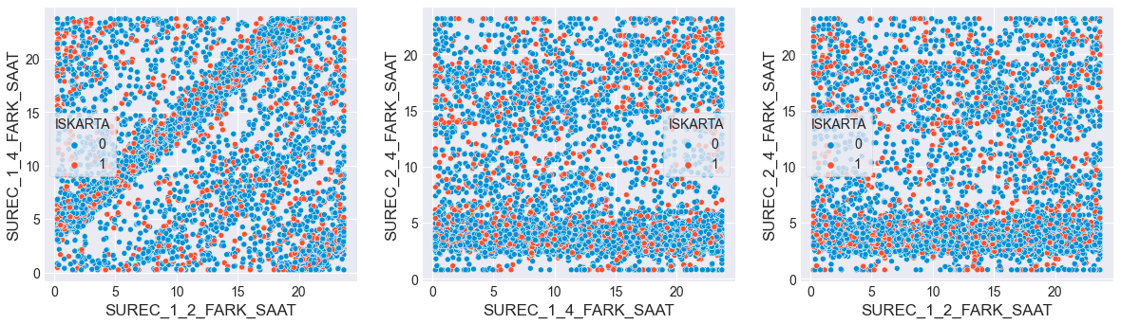
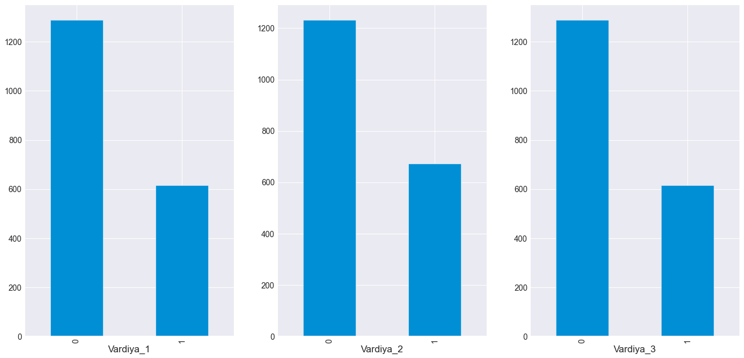
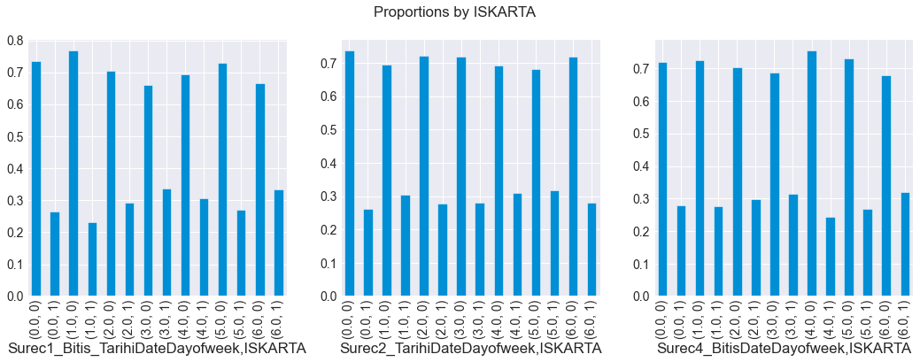
DATA PREPARATION Feature Extraction
We determine the differences as hours between phases.
Number of products vs. Shifts
We create features as 'month', 'day', 'dayofweek', 'dayofyear' for each phase

Slide 7
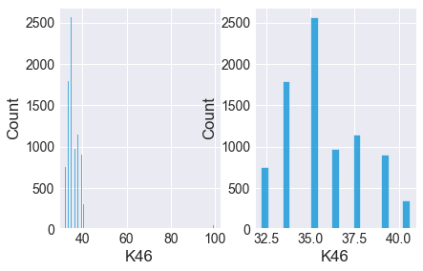
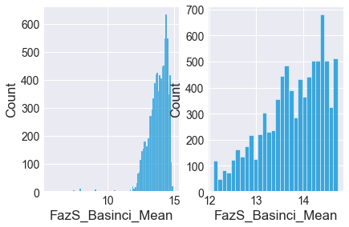
DATA PREPARATION
Outlier Handling
Since there was very few data to begin with, it didn’t seem logical to drop the outliers instead preserving the distribution outlier values are modified to be placed at the 1-99% boundaries.

Slide 8
DATA PREPARATION
Drop Unused Columns
Kalite and PART_No columns are dropped.
Missing Value Handling
Some of the missing values are seen together. This relationship will be tagged a value between 0 and 1 on the graphically.
Rates of missing values are examined for each feature. Columns having higher rate then 95% are dropped.

Slide 9
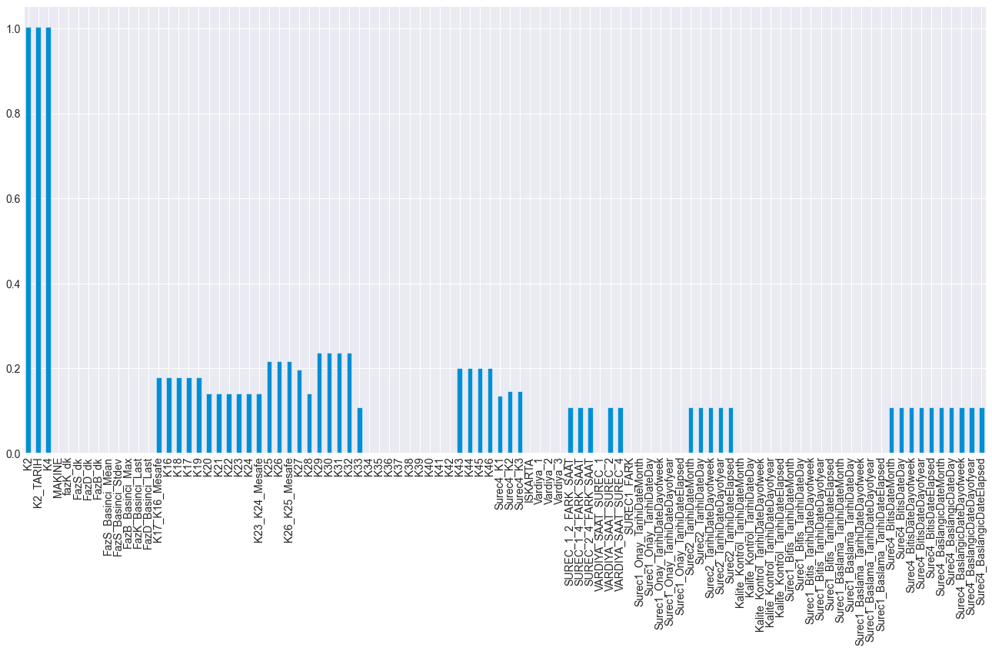

Slide 10
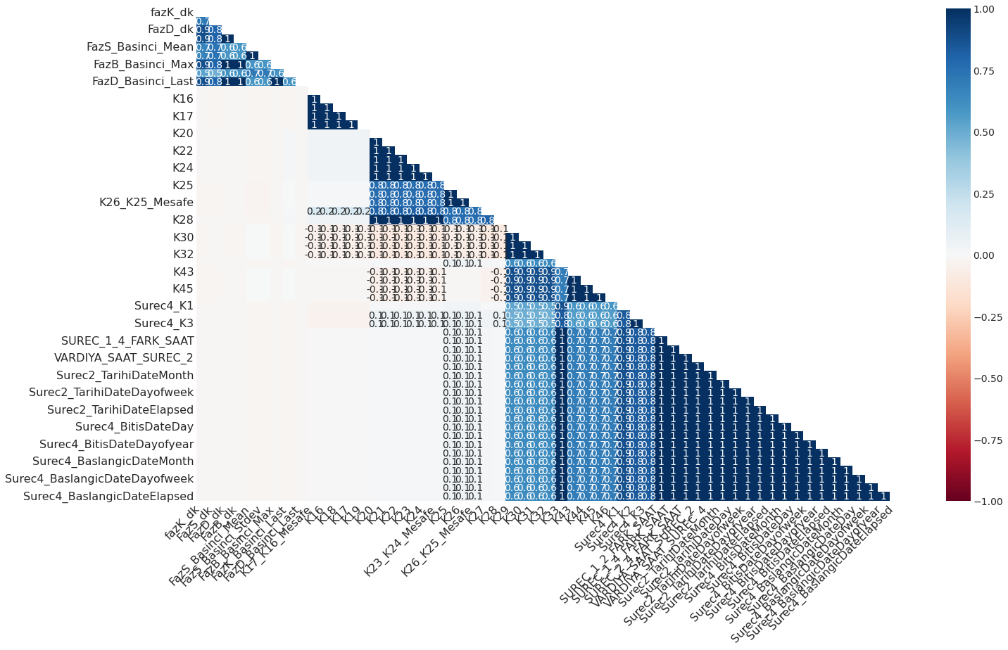

Slide 11
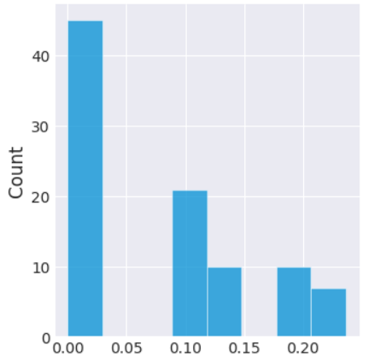
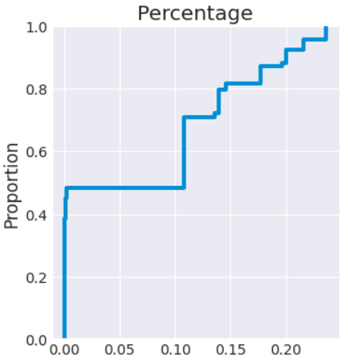
DATA PREPARATION
Missing Value Handling
SimpleImputer() is used to fill the missing values with “median” values. Other functions such as “mean” and “most frequent” are also tested yielding similar results.
Rates of Missing Values

Slide 12
DATA PREPARATION
Encoding Categorical Variables
Original dataset had only 2 categorical variable. After feature extraction, some other categorical features are derived like day of week, hour and month.
For columns which consists from 2 values we used Label Encoder. Otherwise, One Hot Encoding was used to convert data.
Dummy Variable Trap are taken into account.
Train-Test Splits
Different train-test splitting techniques used on modelling phase. First, all columns included on splits, then only significant columns included for retrained models. For autoencoder model a special way preferred.

Slide 13
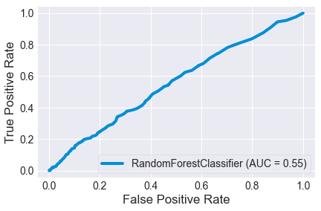
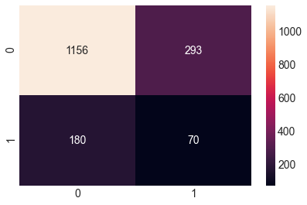
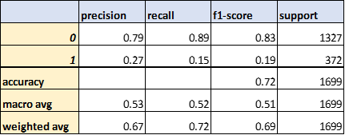
MODELLING
Random Forest Classifier

Slide 14
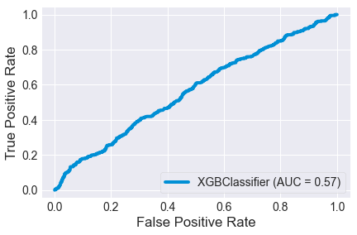
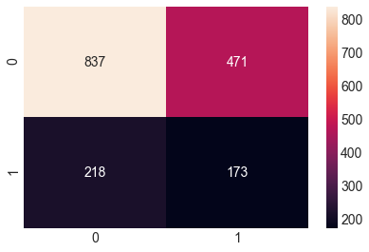
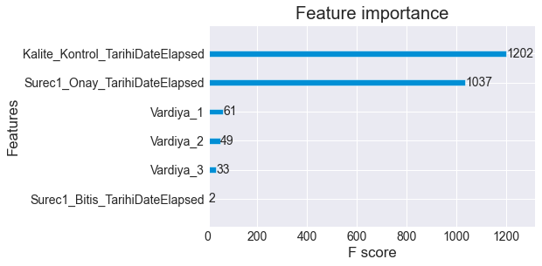
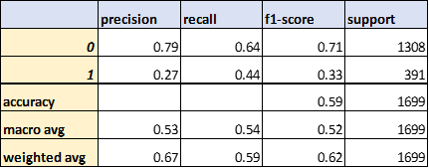
MODELLING
XGBoost Classifier

Slide 15

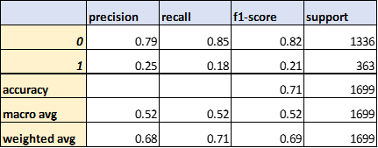
MODELLING
Neural Networks

Slide 16
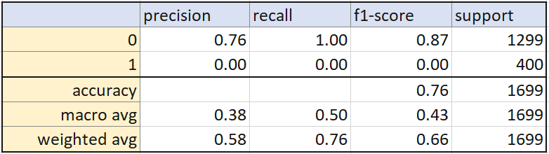
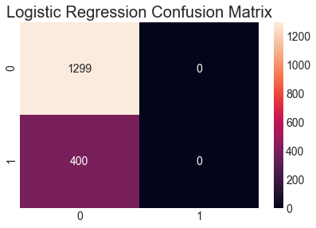
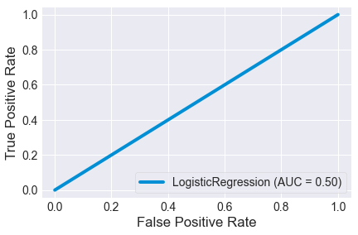
MODELLING
Logistic Regression

Slide 17
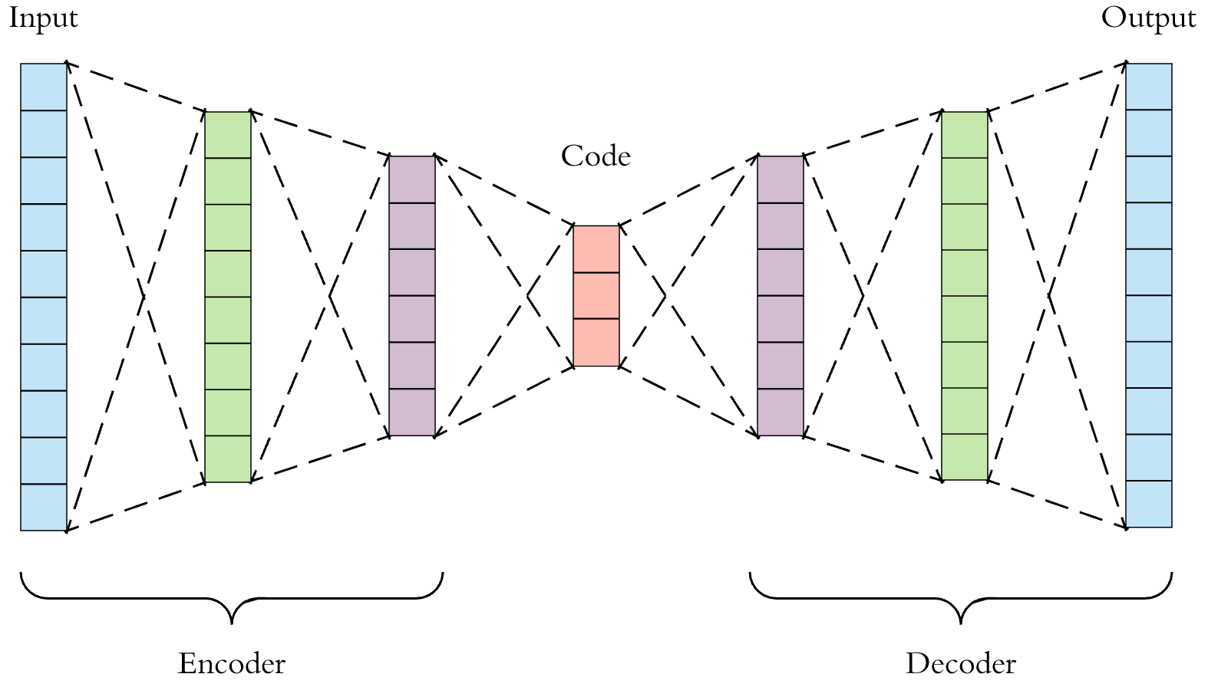
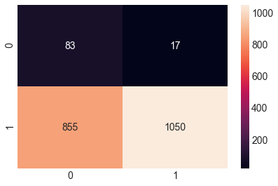
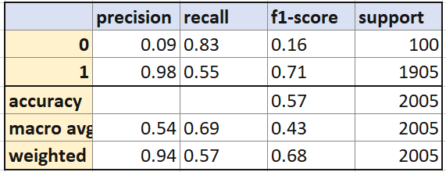
Modelling
One Class Learning with AutoEncoder
Since there are too few data to train an autoencoder, only 100 negative samples were taken for test and used the rest of data to train. But also getting 1000 test samples did not change the results much.
AutoEncoder Image Source : https://towardsdatascience.com/applied-deep-learning-part-3-autoencoders-1c083af4d798

Slide 18
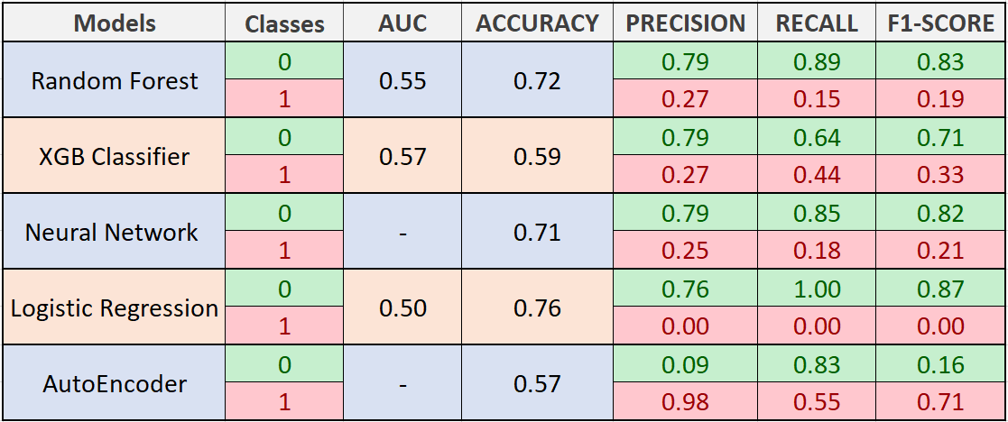
Modelling
MODEL COMPARISON

Slide 19
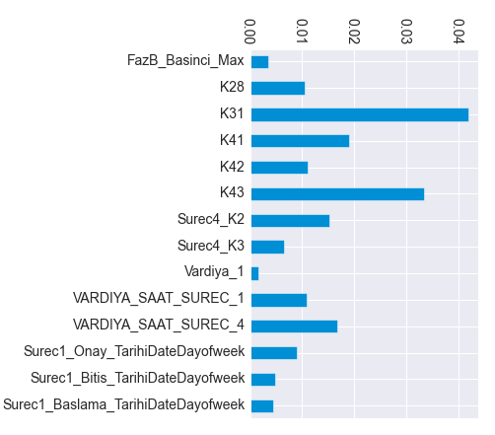
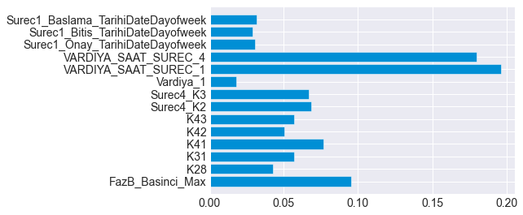
ANALYSIS
P values of each column are investigated in data according to target variable. Some of the variables which are created on feature engineering section are considered meaningful wrt their p values. Also, testing is seen to be in compliance with the featured importances extracted from modelling.

Slide 20
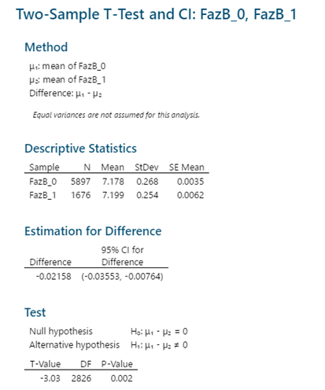
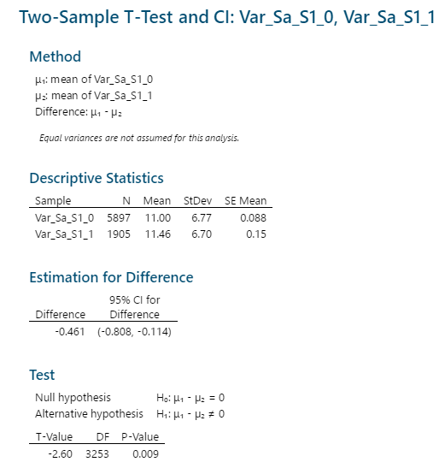
ANALYSIS
Review of Hypothesis Testing

Slide 21
Conclusion
In this project, we examined whether it is possible to model and predict defective products before the production process ends. Also, it is important to find which phases of production causes defective products. Hence, the production line could be redesigned and defective rates could be decreased.
The final conclusion of this analysis is, since there are lots of unmeasured and randomized affects on product phase, it is hard to predict defective products before process ends. But some phases of production has affects on outcome via probility of being defective. These findings have been presented. By redesigning production phase with respect to findings, could decrease defective product rate.
Also there is some unofficial and non-significant results including affects like working at Sunday and Faz_D_Basinci_Last.
This project has higher cost than acceptable, with respect to our Expected Value formula. Because all models comes with high rate of false positives.
Interpretation of the analysis is profoundly bond to the knowledge about production cycle.
THANKS FOR LISTENING
Project and Dataset: https://drive.google.com/drive/folders/1C0Ez6EguomlciwFHzrb6K_hesaDxh0xH?usp=sharing

